Slide 1
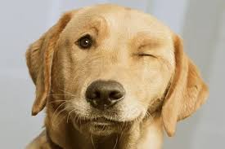
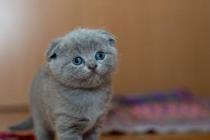
image classification ( Cat and dog )
Convolutional Neural Network
Capstone Project - Lai Soo Seng

Slide 2
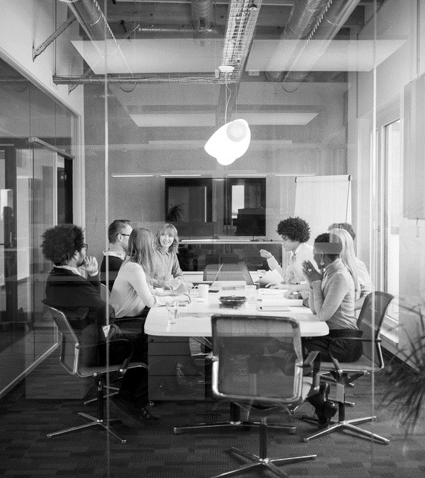
Contents
Introduction
Preparation for the Model
Preprocessing data
Split data
Build model
Evaluation Model
Test

Slide 3
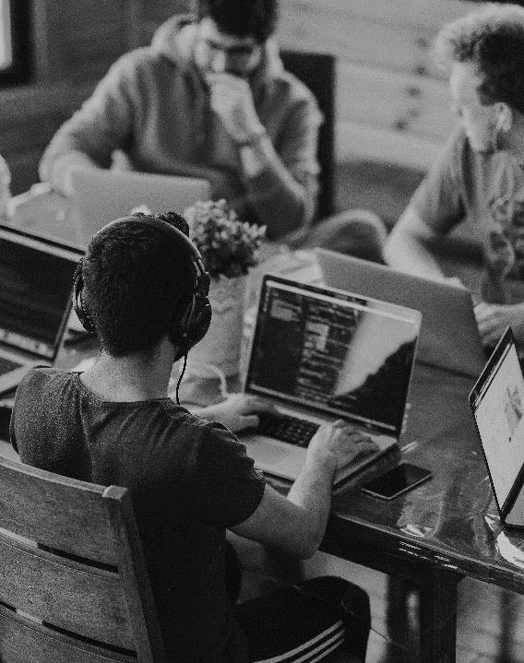
INTRODUCTION
Image classification is the process of assigning a label to an image based on its content. For example, an image classification model might be trained to recognize different types of animals, such as dogs, cats, and birds. Given a new image, the model would analyze the image and predict which of these classes the image belongs to.
Notes:
Image classification is the process to

Slide 4

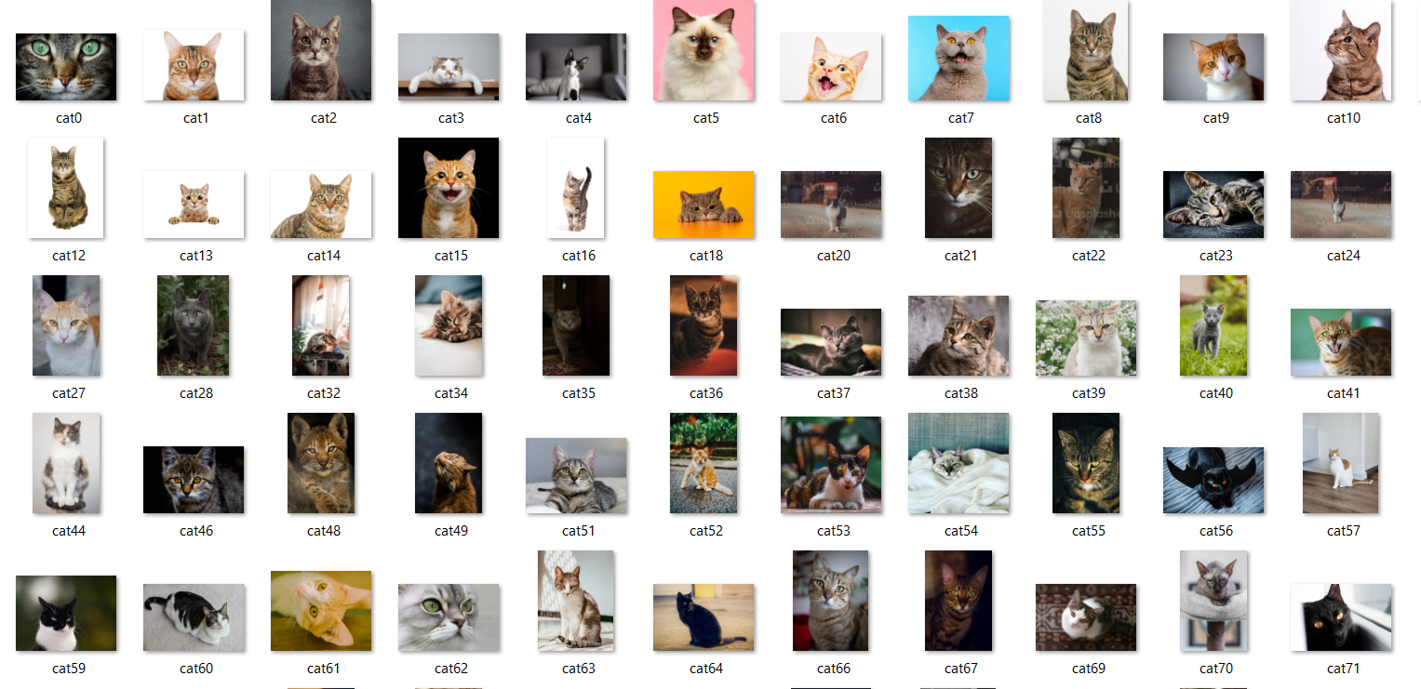

Preparation for the model
Dataset
Environment
Storage
Selenium scrap from google search website.
Dog = 280 images
Cat = 280 images
To make ensure that the model is running in a consistent and predictable environment, we can use the Google Colab .
Google Colab provides free access to GPUs, which can significantly speed up the training process for a CNN model
Upload all the image to google drive, Colab is integrated with Google Drive, allowing you to easily save and load your models and data.

Slide 5
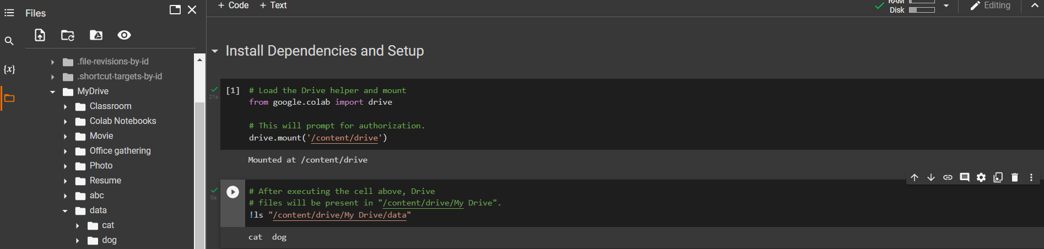
Connect google drive
Notes:
1. To allows the model learn the features and patterns,
2. I have try to use Vs studio to run the model, but it crash
3. In this case, I have use colab to run my project.
4. To save the storage space for this 560 image, I will store the image to the google drive

Slide 6
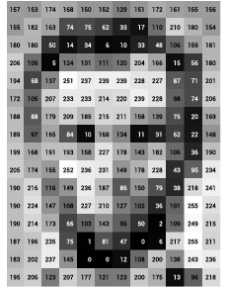
How machine know the image?
An image is made up of a grid of pixels, with each pixel containing a value that represents the color and intensity of the light at that point in the image.

Slide 7
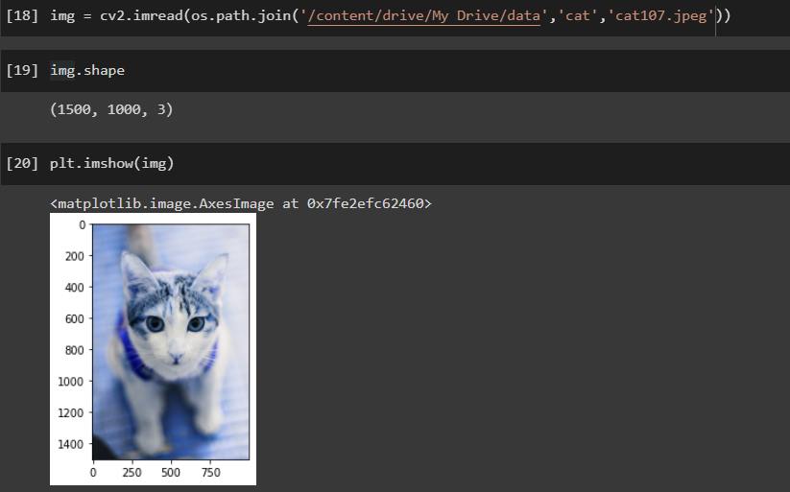
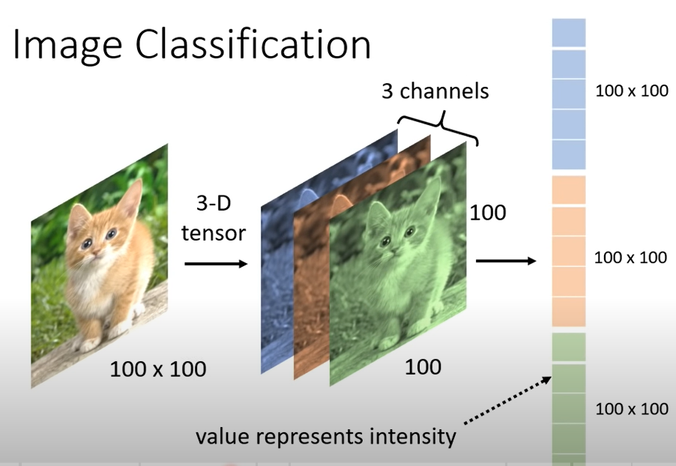
To represent the image as a value, we will use the Opencv to convert the image to Numpy array.
Opencv is a library of programming functions for real-time computer vision. Is typically used for tasks such as image classification, object detection, and image processing.
Numpy array
Height = 1500
Width = 1000
Channels = 3
( Height x Width x Channel )
Black and white = 1 Channel
Color (Red, Green, Blue) = 3 Channel
Notes:
All pixel is include 3 colour Red , Green and Blue

Slide 8
Reduce the amount of memory needed to train the model.
Improve the performance of model - Batching images and resize the image
Improve the generalization of the model
Improve the training speed of the model. If using a GPU, which can process multiple images concurrently.
Notes:
Model can process a batch of images at the same time rather than loading the entire dataset into memory at once

Slide 9
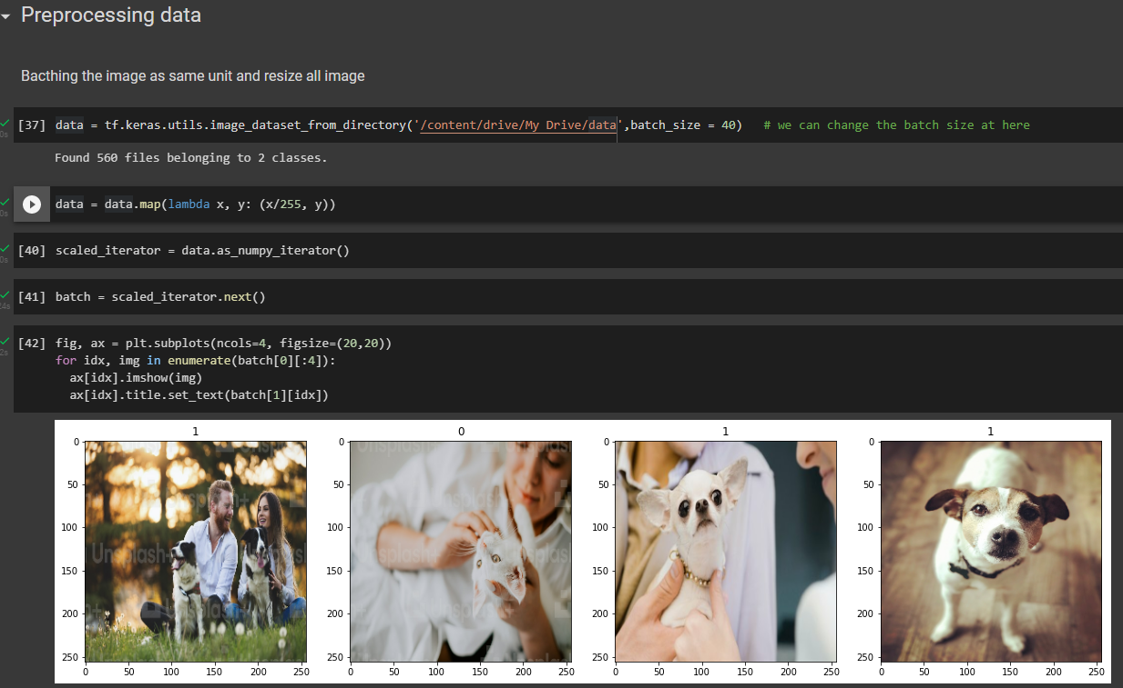
560 image contribute to 40 image per batch (total have 14 batch )
Normalizing the pixel values to make all image same size. scaling the pixel values to a specific range, such as 0 to 1 or -1 to 1
convert a batch of image to an iterator of NumPy arrays.
After re-scale the pixel value, model will know that Cat = 0 , Dog = 1 , which mean the value less than 0.5 is Cat, else more than 0.5 is Dog
Notes:
Bagging image to all same volume

Slide 10
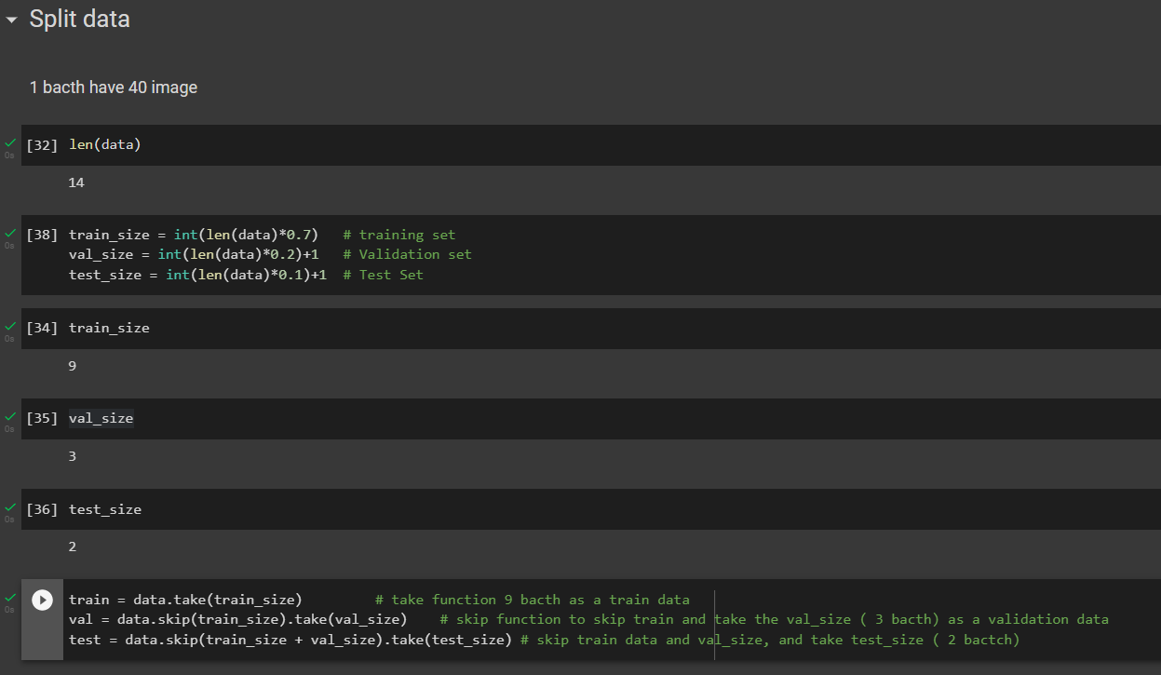
70% for train set
20% for validation set
10% for test set

Slide 11
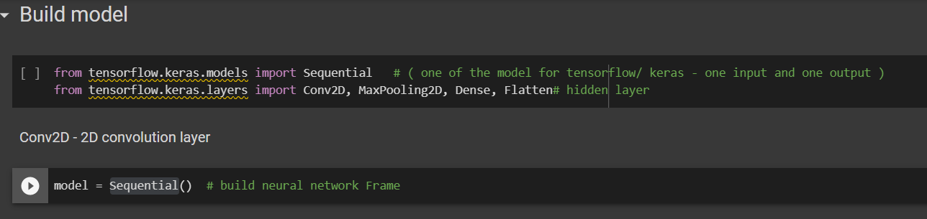
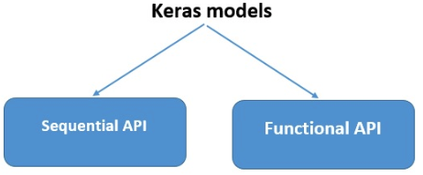
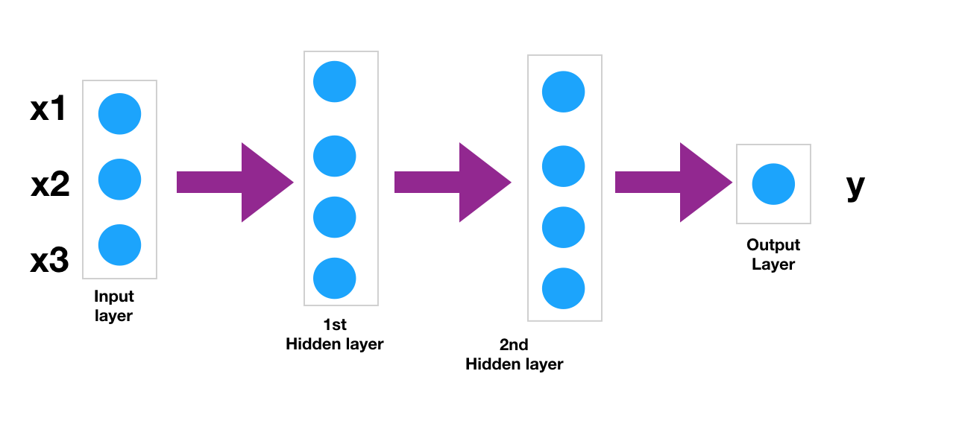
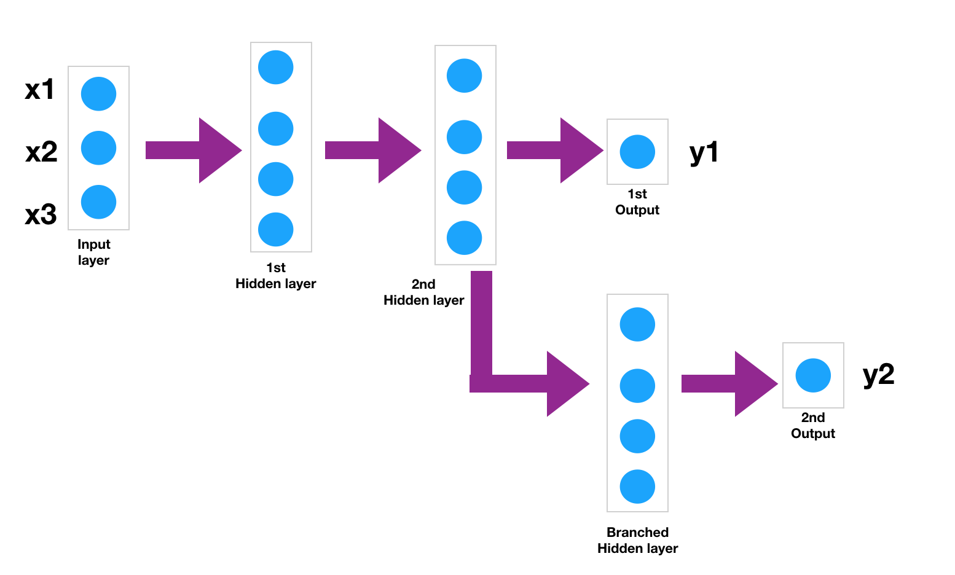
One Input and one output
Layer cannot branching
Multiple Inputs and multiple outputs.
Layers can branching
Notes:
Sequential and Functional API is a function to build up the neural network framework/ Structure – only the different is Sq Api is only able one input and one output and Func can multiple input and multiple output

Slide 12

Neural Network Structure

Slide 13
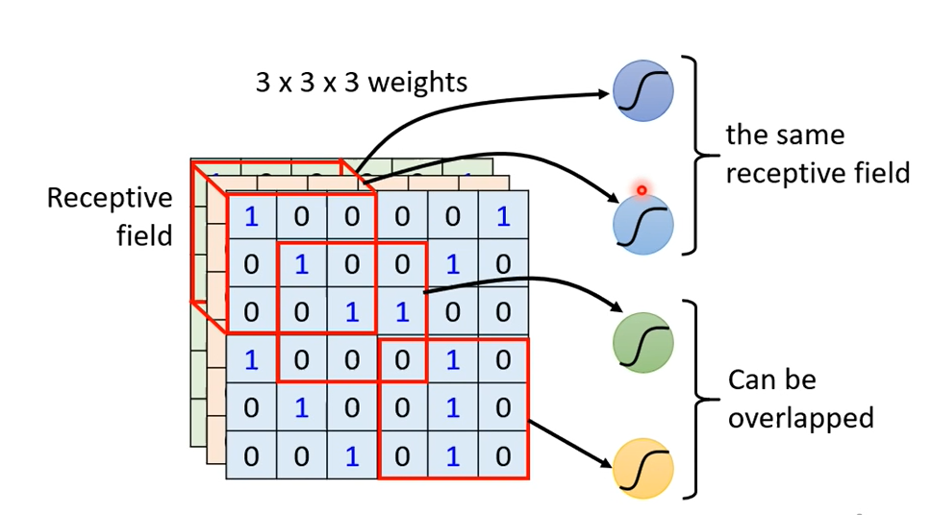
Convolutional layer
Convolutional layer is the process to use the different neuron to catch up the different receptive field region
1. Design receptive field size base on the case.
2. Receptive field can overlap for every single neuron and the multiple neuron to catch up one receptive field
3. Neuron = kernel size x filter
Notes:
If use one neuron run thru all the pixel, the process is not effiective. That why we use CNN process. We can design the receptive field and let the different neuron to catch up the selected receptive field .
Receptive field can overlap for every single neuron and the multiple neuron to catch up one receptive field
Is that 3 channel have 3 different receptive field? Yes, but that is Network Corporation model.
Is that receptive filed is other shape? Yes, but that depend on the pattern
Design receptive field for minimise the area and let the different neuron to catch up the different area pattern
CNN is the process to use the different neuron to catch up the different receptive filed region

Slide 14
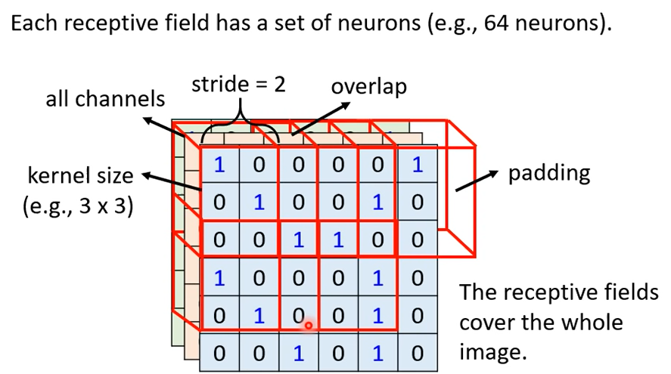
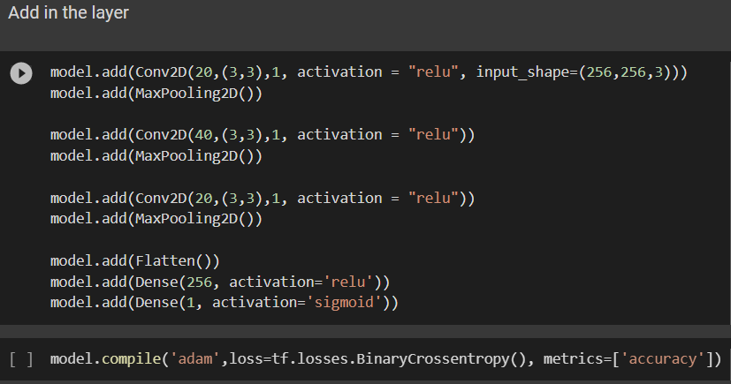
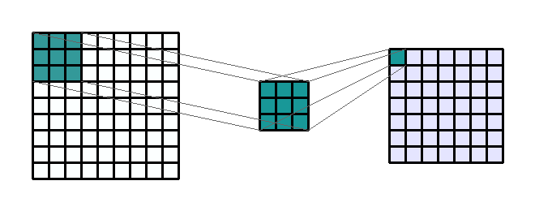
Kernel Size
Stride = 1 ( move receptive field for every 1 grid to overlap the receptive field )
Filter
the shape of the input data that a layer of a network receives
Sigmoid because we need to predict Probability
Conv2d – Using Kernel size to filter the input image to catch up the pattern.
MaxPooling2D(Subsampling) – minimize the image to reduce time calculation.
ReLU (Rectified Linear Unit) – This operator make original entities of input image not to be negative.
Flatten – To let the feature map from 2D to 1D.
Dense – Received all the input and generate one output
Notes:
Conv2d - Zoom in the input image and use filter to catch up the pattern

Slide 15
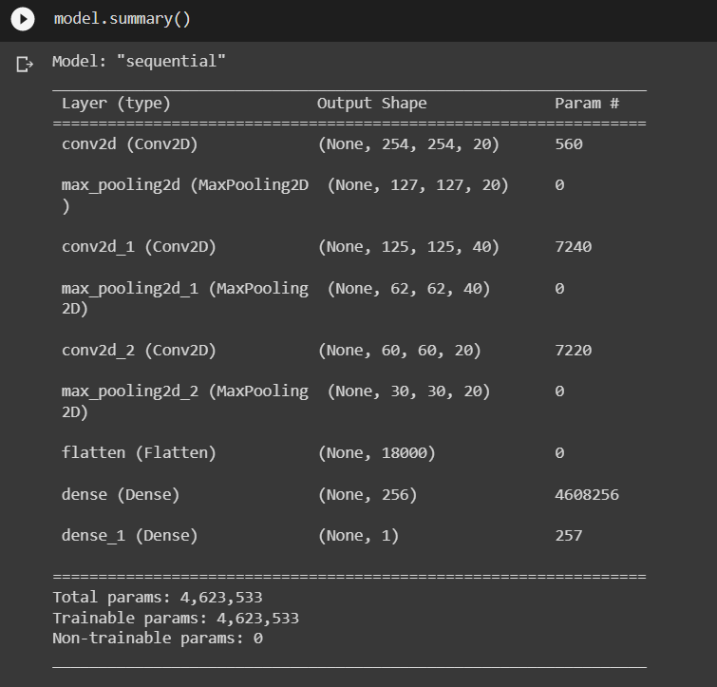
1st Layer - (3 x 3 x 3 + 1 (bias)) x 20 filter = 560 parameters
2nd Layer - (20 (previous filter) x 3 x 3 + 1 (bias)) x 40 filter = 7,240 parameters
3rd Layer - (40 (previous filter) x 3 x 3 + 1 (bias)) x 20 filter = 7,220 parameters
Flatten output is 30 x 30 x 20 = 18,000 flatten output (Flatten didn’t learn anything , so param is 0 )
256 x (18000 + 1 ) = 4,608,256
256 + 1 ( Bias) = 257

Slide 16
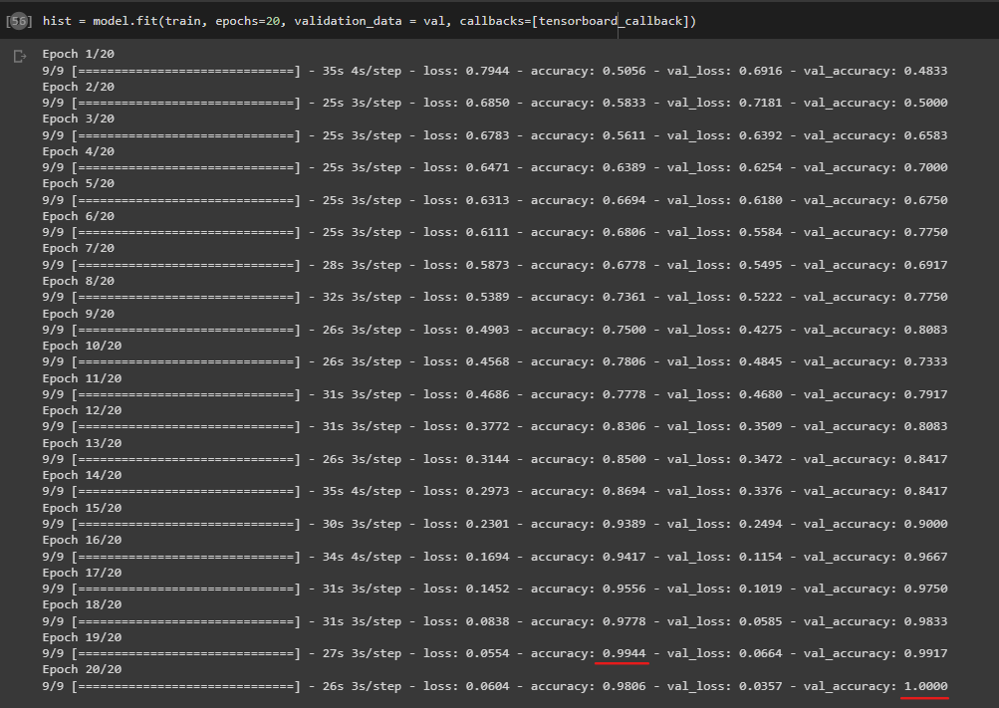

Slide 17
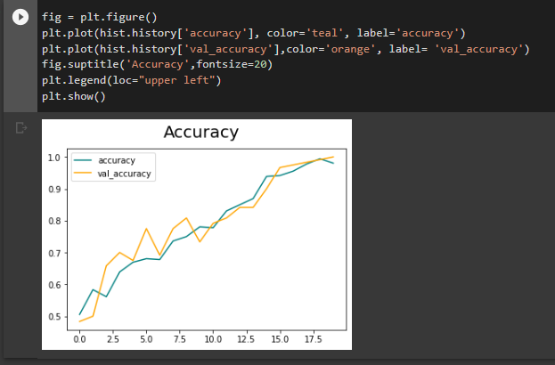
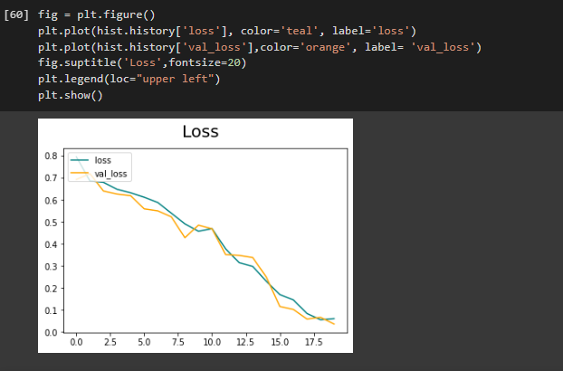
When model training more, both set of accuracy become higher.
At the end of the Training and Validation set, accuracy near to 100%.
During Model training more, both set of loss become lower.
At the end of the Training and Validation set, loss near to 0%

Slide 18
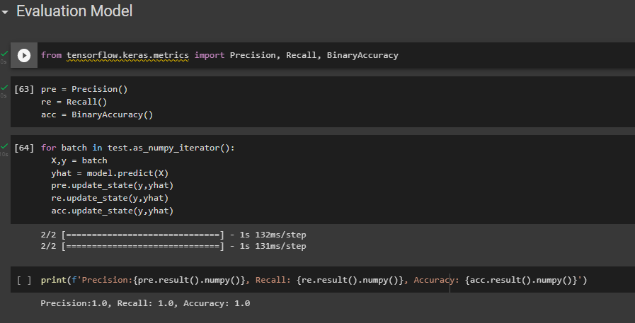
Classification problem

Slide 19
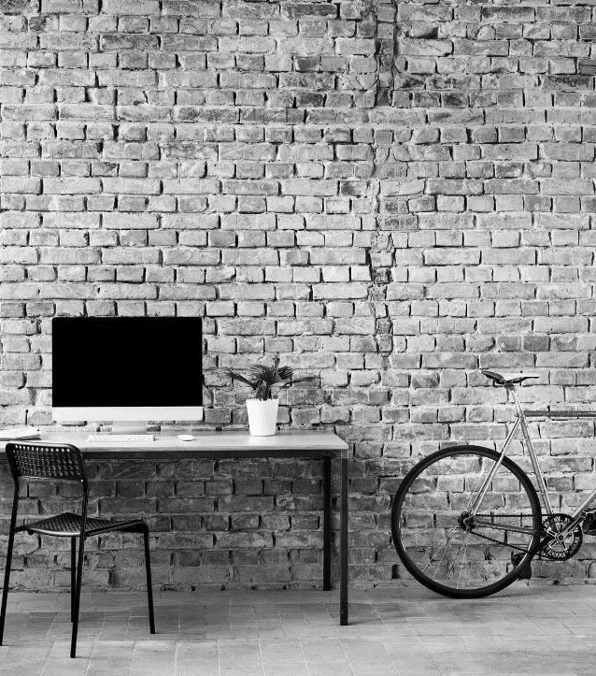
What’s next
Test the model

Slide 20
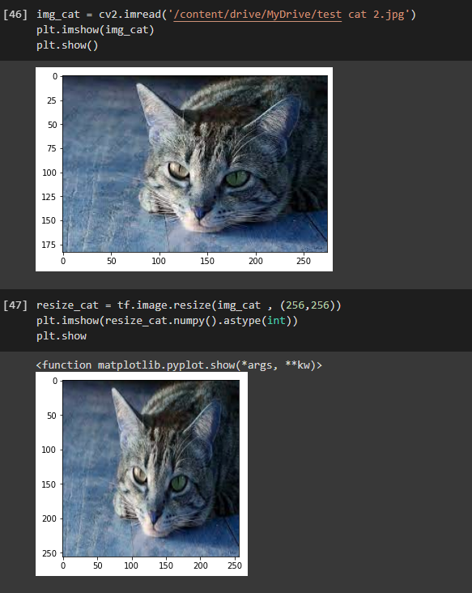
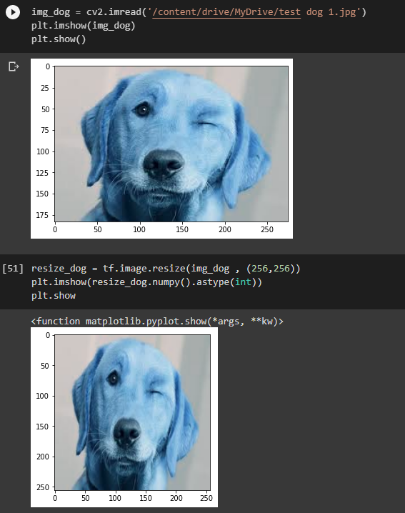
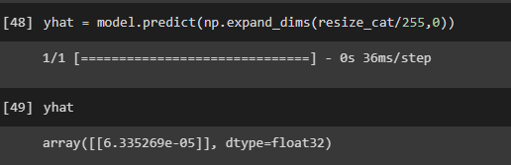
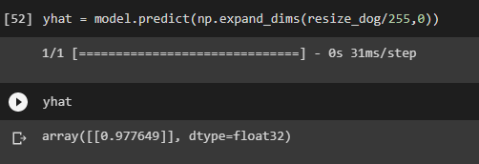

Slide 21
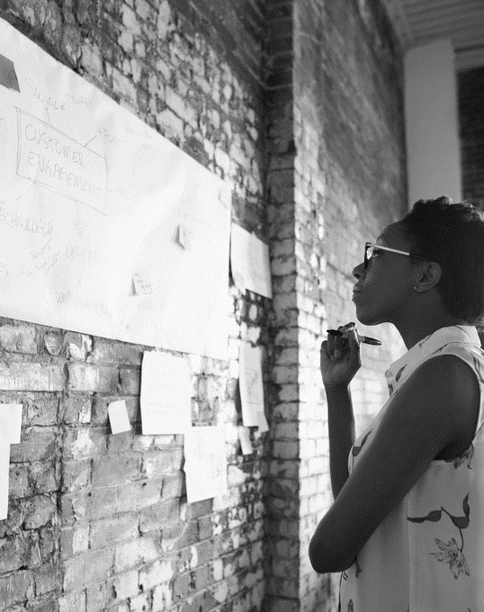
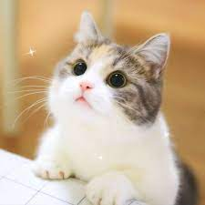
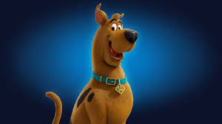
Demo

Slide 22
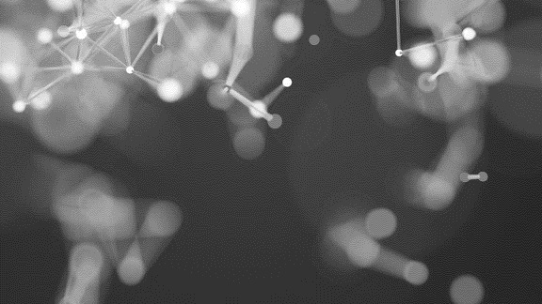
THANK YOU
https://github.com/Ansonex/Image-Classification-Cat-and-Dog-/blob/main/ImageClassification.ipynb

